Slide 1
Xxxii anniversary of the magna charta universitatum
16-17 june 2021

Slide 2
University values and responsabilities: responding to the challenges of the future
Launch and signature of the magna charta universitatum 20020

Slide 3
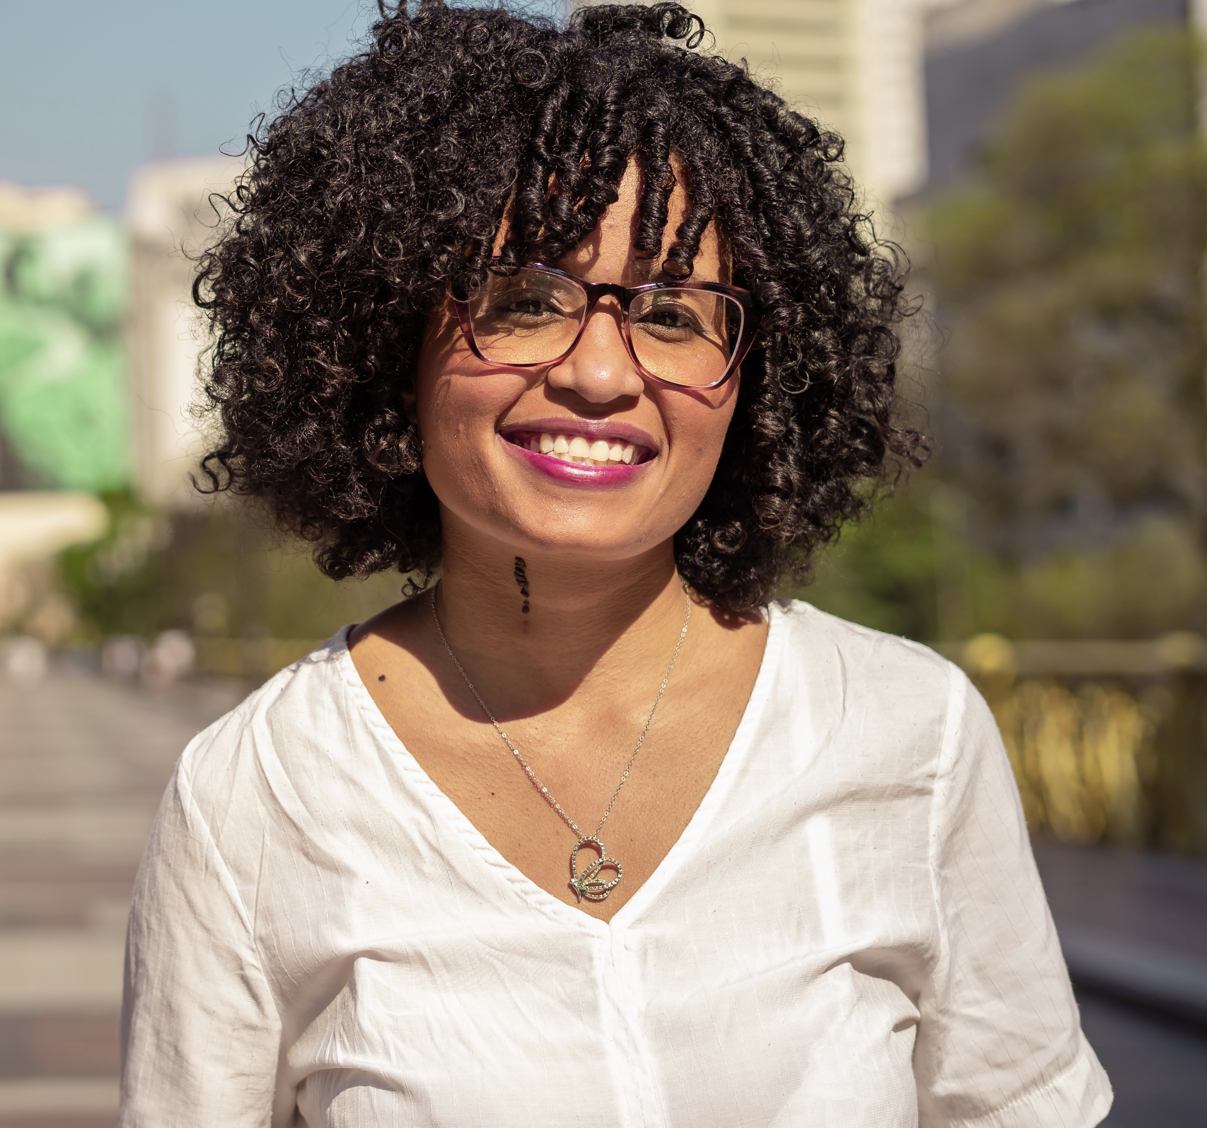
Tamires gomes sampaio
is a lawyer, master in Political and Economic Law. She was president of the Law Students Union of Mackenzie Presbiterian University (2014-2015) and vice president of the National Union of Students of Brazil (UNE) during 2015 to 2017. She participated in the Global Student Voice seminar in Norway in 2016 representing UNE and was one of the student leaders who wrote the Bergen Declaration.
She was the student representative of the drafting group of Magna Charta Universitatum 2020.

Slide 4
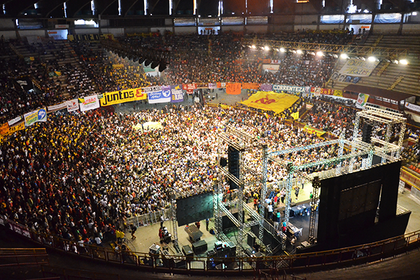
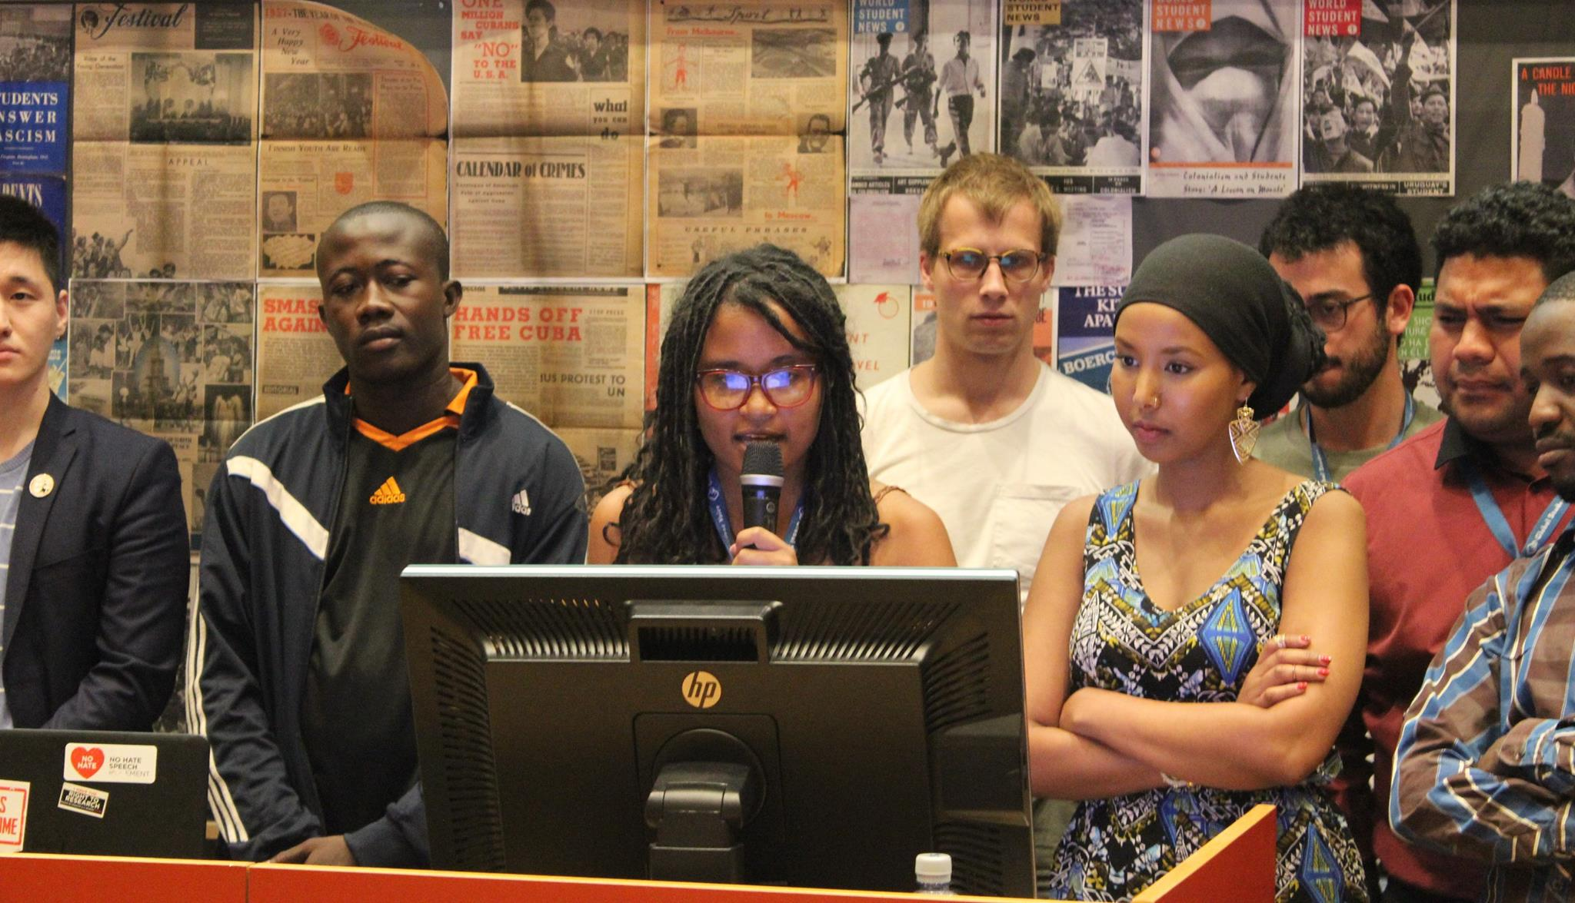
What the new mcu means for students?
final plenary of the UNE national congress 2017
Reading of the Bergen Declaration in 2016 (Norway)

Slide 5
Bergen declaration
The Bergen Declaration was drafted and agreed on by the participating National students unions from all over the World during the Global Student Voice seminar in Bergen. The Declaration was drafted by student representatives from South America, North America, Europe, Africa, Asia, and the Pacific in May 2016.

Slide 6
Bergen declaration
Uniting for a global student voice
Education is a Human Right
Students’ rights (quality education, students organization, autonomy, etc)
Access to tertiary education (education should be a public and universal good)
Sustainability, Mobility and Safety
Global Students Voice (Global Student Forum)

Slide 7
Mcu 1988 and students
“Each university must – with due allowance for particular circumstances – ensure that it’s students’ freedoms are safeguardED, and that THEY enjoy consessions in which They can acquire the culture and training which it is their purpose to possess.”
- MCU 1988

Slide 8
MCU 2020 and students
“The Magna Charta Universitatum, a declaration and affirmation of the fundamental principles upon which the mission of universities should be based, was signed in 1988 on the occasion of the 900th anniversary of the University of Bologna.”
Here in Brazil, we learned that the tripod that provide the basis for higher education is teaching, research and extension. When we talk about the principles being implemented I would say that there is another tripod: the direction, the professors and the students.

Slide 9
Mcu 2020 and students
Worldwide, the student movement calls for greater student participation in the direction of universities and when we include students in MCU 2020 we are recognizing them as a fundamental part of implementing these principles.

Slide 10
Mcu 2020 and students
“The second was that teaching and research should be inseparable, with students engaged in the search for knowledge and greater understanding.”
“Globally the number and diversity of students seeking a university education has increased, as have their reasons for doing so and the expectations of their families and communities.”
“As they create and disseminate knowledge, universities question dogmas and established doctrines and encourage critical thinking in all students and scholars. Academic freedom is their lifeblood; open enquiry and dialogue their nourishment.”

Slide 11
Mcu 2020 and students
“Universities are non-discriminatory spaces of tolerance and respect where diversity of perspectives flourishes and where inclusivity, anchored in principles of equity and fairness, prevails. They therefore commit themselves to advance equity and fairness in all aspects of academic life including admissions, hiring and promotion practices.”
“Education is a human right, a public good, and should be available to all. Universities recognise that learning is a lifelong activity with tertiary education as one part of a continuum. Within that one part, universities serve diverse learners at all stages of their lives.”

Slide 12
What the new mcu means for students?
a recognition that we are part of the university not only as passive subjects, but as active actors who are part of the construction and implementation of the principles that MCU defends.

Slide 13
Thank you!
Questions?
Tamires Gomes Sampaio
E-mail: tamylpdf@gmail.com
@soutamires.sp

